Slide 1




Data-Limited Fisheries Toolkit
Evaluating management strategies for data-limited fish species
Specifying MPs and other MSE outputs
Lecture 3a, Nov 8th 2017
Tom Carruthers & Adrian Hordyk .

Slide 2
Agenda
Specifying MPs for MSE
Convergence diagnostics
Value of information (VOI) analysis
Cost of current uncertainties

Slide 3
Specifying MPs for MSE analysis
DLMtool contains two types of MP that provide different types of management recommendation:
Output control MPs (class Output)
Provide a Total Allowable Catch (TAC), e.g. 100,000 tonnes
2. Input control MPs (class Input)
These MPs control the extent of fishing pressure rather than the
amount of fish extracted and can make recommendations in terms of
- Total Allowable Effort (TAE), e.g. 10,000 days of fishing
- Spatial closures (e.g. no take areas)
- Size limits (e.g. only retain fish over 50cm)

Slide 4

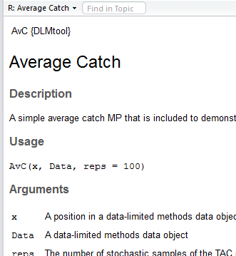
Finding DLMtool MPs
Similarly to other objects in DLMtool you can use the avail()
function to list those that are available:

Slide 5

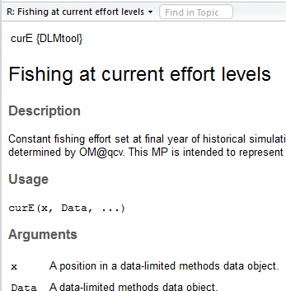
Finding DLMtool MPs
Now for input control MPs

Slide 6
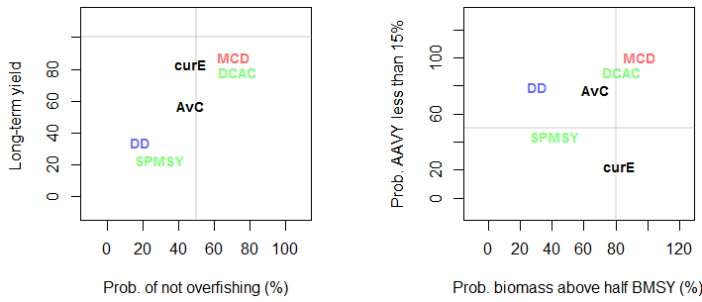
Using selected MPs in an MSE
To evaluate the performance of a set of selected MPs,
you can make a list of their names in R and pass this to the
runMSE() function:
myMPs = c("AvC", "curE", "DCAC", "DD", "MCD", "SPMSY")
myMSE = runMSE(myOM, myMPs)
NOAA_plot(myMSE)

Slide 7
Checking Convergence
By default operating models are run for 48 simulations.
That doesn’t sound like a lot, but how many is enough?
You can check to see whether MP performance is stable using the function Converge()
Converge(myMSE)
This function returns two plots:

Slide 8
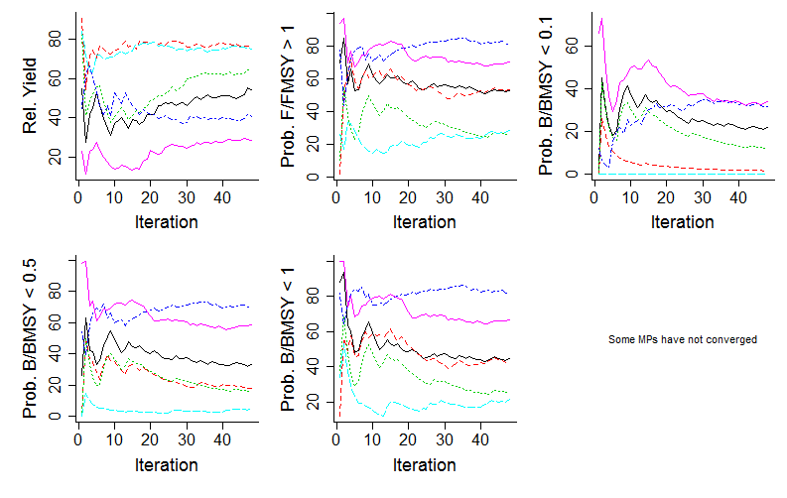
Lines are MPs. The first plot has 5 panels, each one shows the mean performance of a different metric (y axes) as simulations are added (iterations – the x axis)

Slide 9
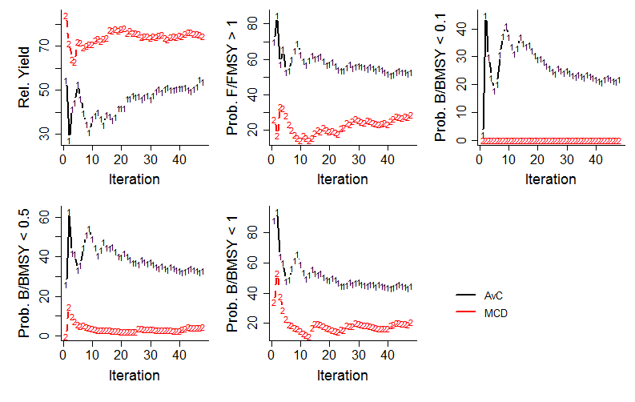
The first plot has noted that some MPs did not converge with respect to 1 or more performance metrics. The second plot (if applicable) highlights these MPs:

Slide 10
Value of information analysis
If we can calculate
- performance for every simulation
and we can track
the conditions of every simulation,
we can analyse which data observation processes are driving performance.
Value of information analysis can identify which data are the most important in successful management.
For any MSE object in DLMtool you can conduct VOI analysis using the VOI() function…

Slide 11
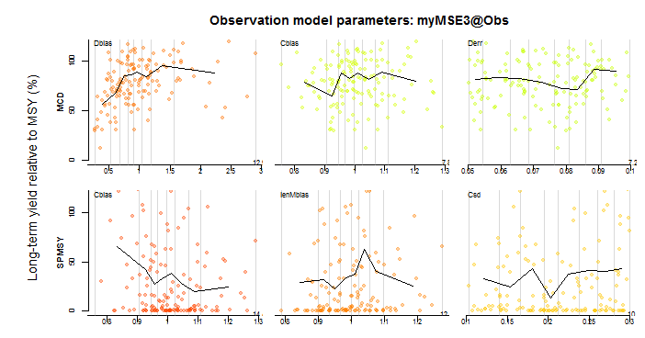
VOI(myMSE)
More critical

Slide 12
Cost of current uncertainties
If we knew more about our current fishery, if our operating model was more certain (e.g. a narrower range of natural mortality rate) then perhaps we could use an MP that will perform better?
This is the cost of current uncertainties and it is similar to VOI analysis. Rather than observation model parameters it correlates performance with the conditions of the operating model to identify simulated conditions over which performance varies.
When VOI is run these CCU plots re actually formed first…

Slide 13
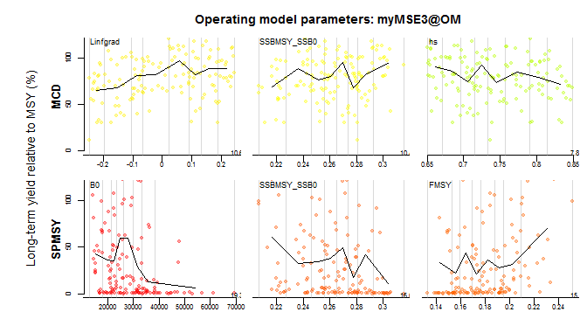
VOI(myMSE)
More critical

Slide 14
Getting help
R help: class?Output
class?Input
?Converge
?VOI

